Slide 1


Master of Science (Computer Science) Sub. Code: COMS 411 Sub. Name: Design of Algorithms
Dr. S. RAVI, Dept. of Computer Science

Slide 2
Definition of Algorithm
The word Algorithm comes from the name of the Persian author, Abu Jafar Mohammed ibn Musa al Khowarishmi (c. 825 A.D).
Al-Khowarizmi meaning from the town of Khowarasm, city is now known as Khiva and located in Uzbekistan, USSR.
Algorism – algorithm.
Any special method of solving a certain kind of problem. (Webster’s dictionary)
Algorithm is composed of a finite set of steps, each of which may require one or more operations.

Slide 3
Problem Solving: Main Steps
Problem definition
Algorithm design / Algorithm specification
Algorithm analysis
Implementation
Testing
[Maintenance]

Slide 4
1. Problem Definition
What is the task to be accomplished?
Calculate the average of the grades for a given student
Understand the talks given out by politicians and translate them in Chinese
What are the time / space / speed / performance requirements ?

Slide 5
2. Algorithm Design / Specifications
Algorithm: Finite set of instructions that, if followed, accomplishes a particular task.
Describe: in natural language / pseudo-code / diagrams / etc.
Criteria to follow:
Input: Zero or more quantities (externally produced)
Output: One or more quantities
Definiteness: Clarity, precision of each instruction
Finiteness: The algorithm has to stop after a finite (may be very large) number of steps
Effectiveness: Each instruction has to be basic enough and feasible
Understand speech
Translate to Chinese

Slide 6
Computer Algorithms
An algorithm is a procedure (a finite set of well-defined instructions) for accomplishing some tasks which,
given an initial state
terminate in a defined end-state
The computational complexity and efficient implementation of the algorithm are important in computing, and this depends on suitable data structures.

Slide 7
4,5,6: Implementation, Testing, Maintainance
Implementation
Decide on the programming language to use
C, C++, Lisp, Java, Perl, Prolog, assembly, etc. , etc.
Write clean, well documented code
Test, test, test
Integrate feedback from users, fix bugs, ensure compatibility across different versions → Maintenance

Slide 8
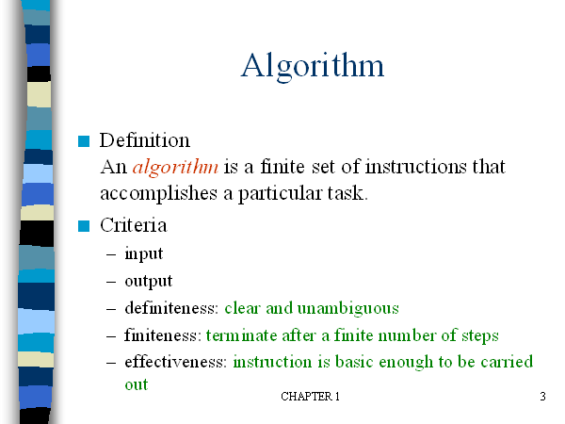
- Zero or more quantities should be externally supplied
-At least one quantity is produced
by a person using only pencil and paper

Slide 9
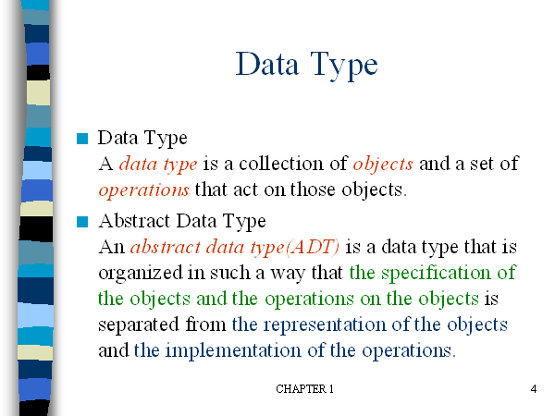

Slide 10
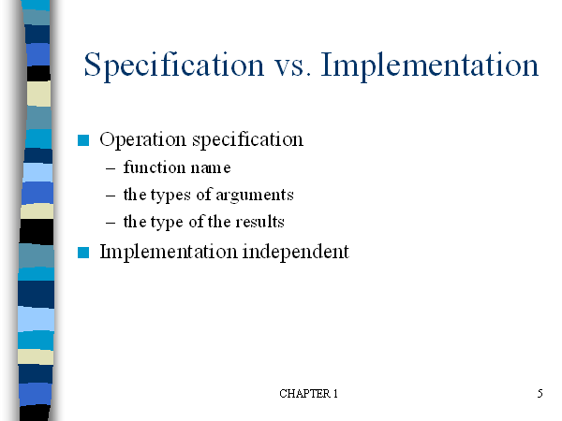

Slide 11
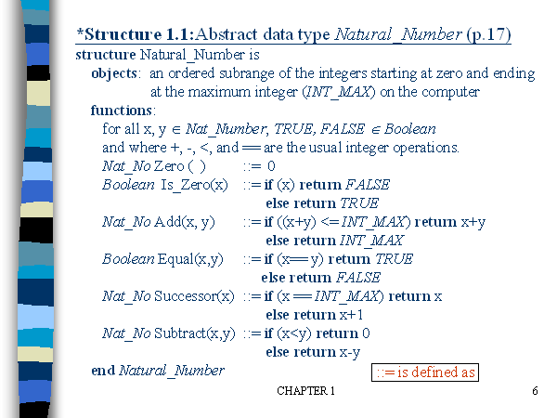

Slide 12
How to create programs
Seat of pants method: Write something down and then try to get it working.
The process of creating programs is split into five phases:
i) Requirements: Understand the information given (the inputs) and what results U R to produce (the outputs)
ii) Design: For each object there will be some basic opns to perform on it.
Write an algorithm which solves the problem.
iii) Analysis: Write more than one algorithm. Compare them and choose the best algorithm.
iv) Refinement and coding:
v) Verification: Consists of three distinct aspects:
Program proving: Prove that the program is correct for all possible combination of inputs.
Testing: The art of creating sample data upon which to run UR program.
Debugging: The process of correcting errors

Slide 13
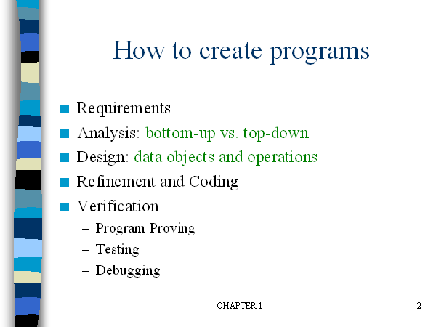

Slide 14
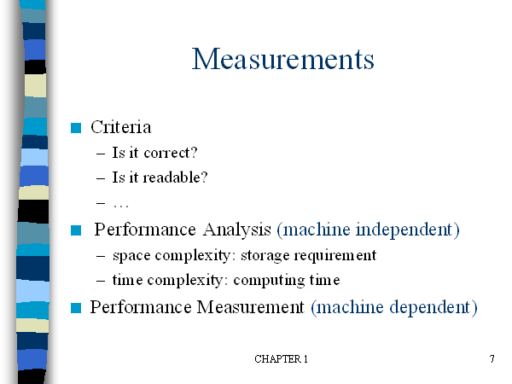

Slide 15
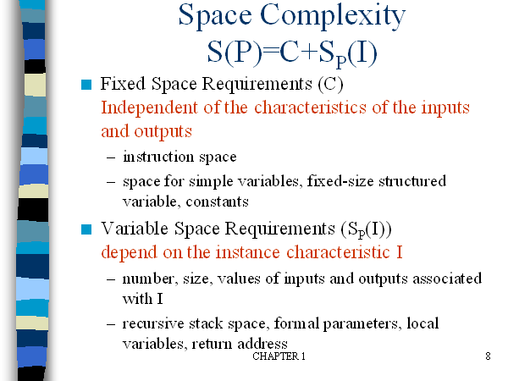

Slide 16
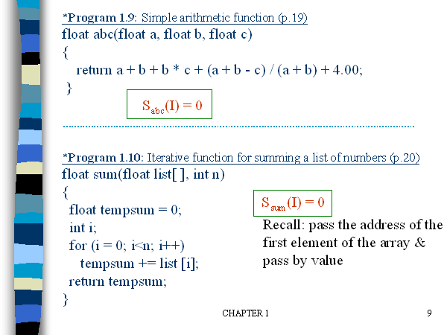

Slide 17
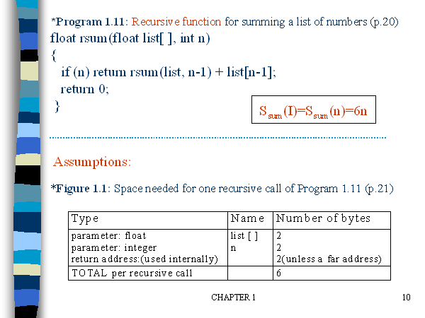

Slide 18
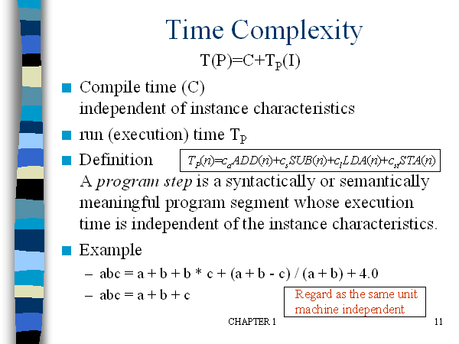

Slide 19
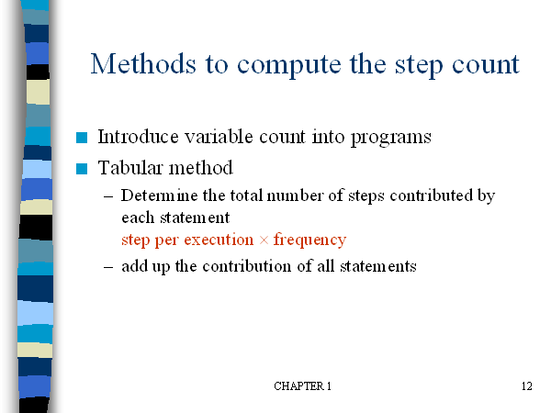

Slide 20
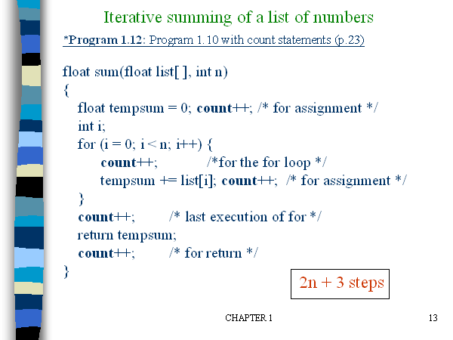

Slide 21
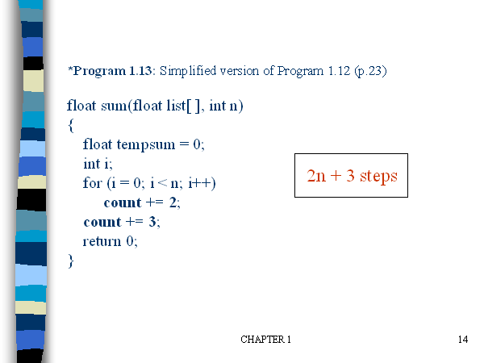

Slide 22
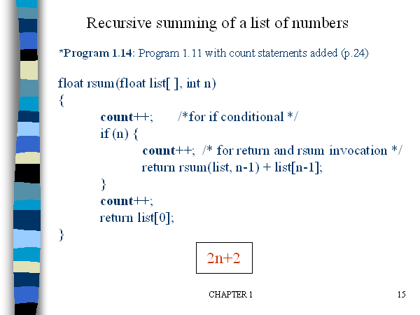

Slide 23
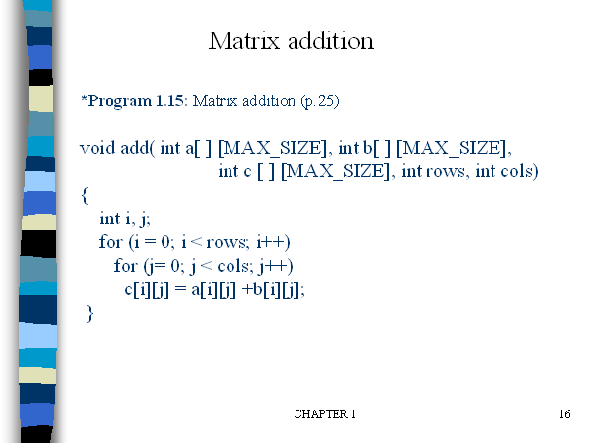

Slide 24
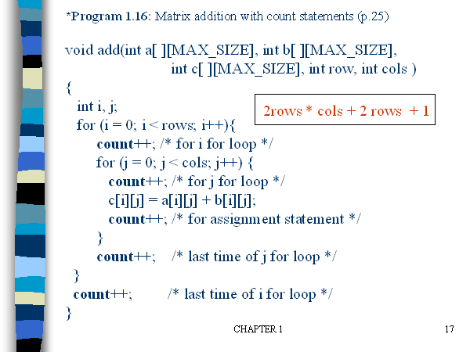

Slide 25
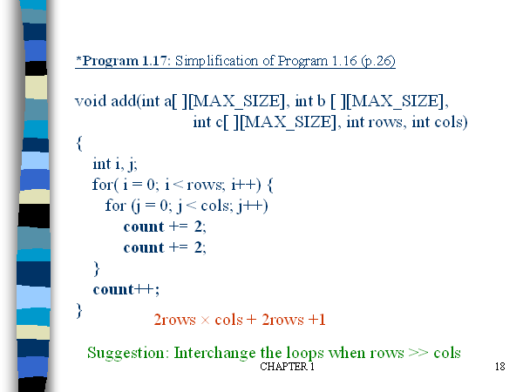

Slide 27
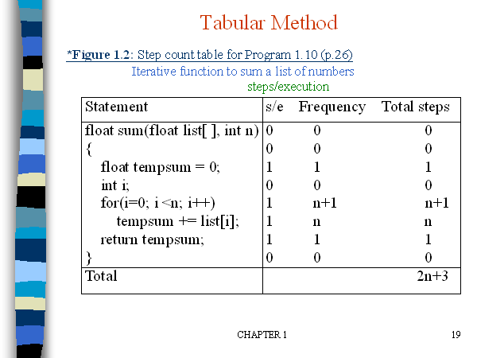

Slide 28
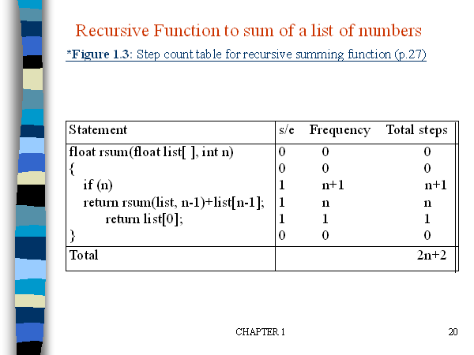

Slide 29
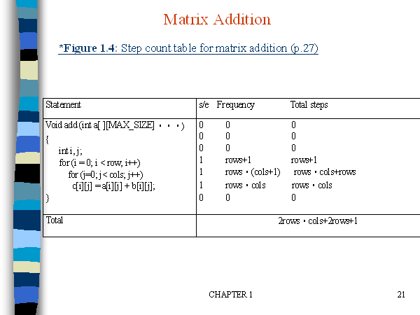

Slide 30
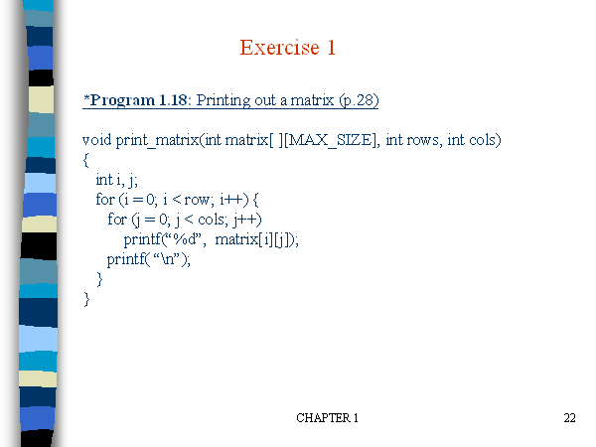

Slide 31
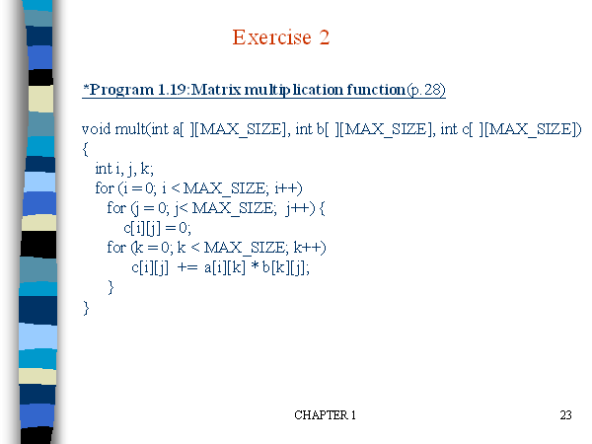

Slide 32
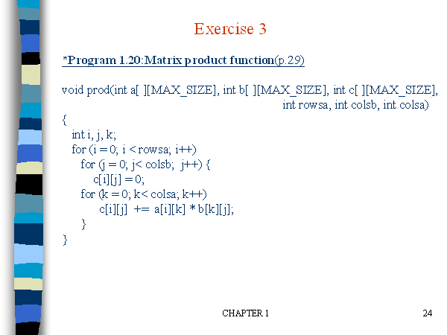

Slide 33
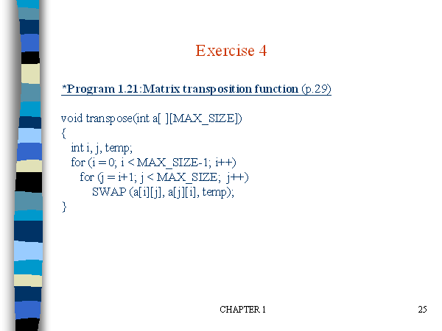

Slide 34
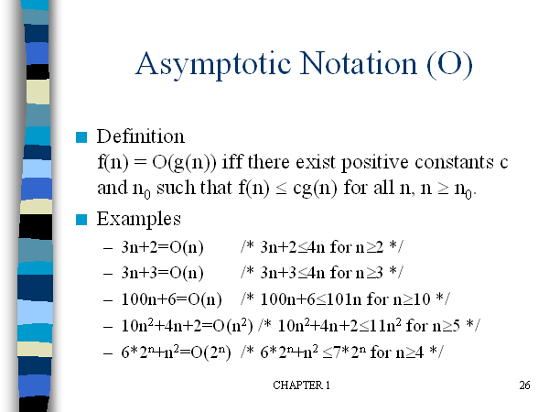

Slide 35
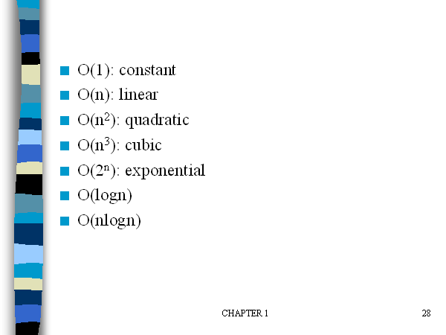

Slide 36
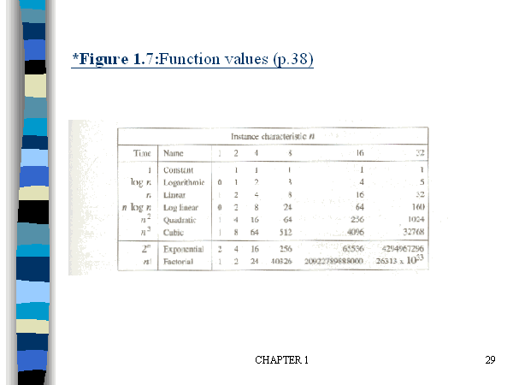

Slide 37
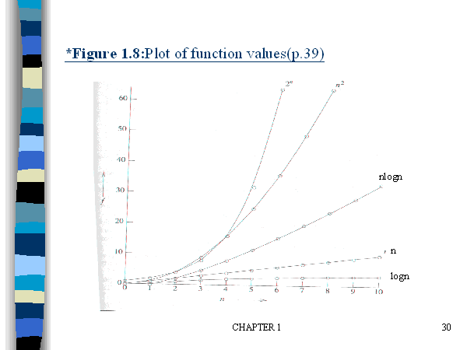

Slide 38
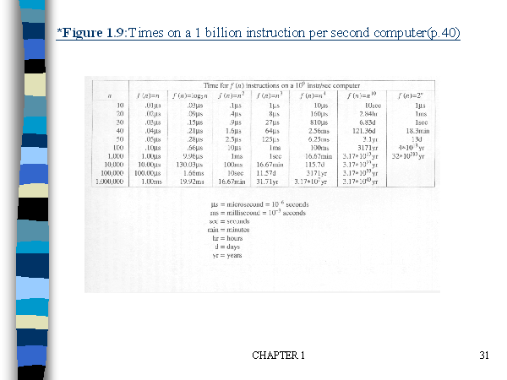

Slide 39
Divide and Conquer Method

Slide 40
1. Divide-Conquer Methods
2. Binary search
3. Merge sort
4. Quick sort

Slide 41
Divide-and-conquer approach
Divide-and-Conquer divides an instance of a problem into two or more smaller instances.
The smaller instances are usually instances of the original problem.
If solutions to the smaller instances can be obtained readily, the solution to the original instance can be obtained by combining these solutions.

Slide 42
If the smaller instances are still too large to be solved readily, they can be divided into still smaller instances.
This process of dividing the instances continues until they are so small that a solution is readily obtainable.

Slide 43
The divide-and-conquer approach is a top down Approach.
That is, the solution to a top-level instance of a problem is obtained by going down and obtaining solutions to smaller instances.
this is the method used by recursive routines.

Slide 44
Divide-and-conquer approach (Cont.)
The divide-and-conquer paradigm involves three steps at each level of the recursion: Divide the problem into a number of subproblems. Conquer the subproblems by solving them recursively. If the subproblem sizes are small enough, however, just solve the subproblems in a straightforward manner. Combine the solutions to the subproblems into the sloution for the original problem.

Slide 45
General Method-control abstraction
Algorithm DAndC(P)
{
If Small(P) then return S(P);
Else
{
Divide P into smaller instances P₁,P₂,….P_{K}. k>=1;
Apply DAndC to each of these subproblems;
Return Combine(DAndC(P₁),DAndC(P₂),…DAndC(P_{K});
}
}

Slide 46
T(n)= { g(n) n small
T(n₁)+T(n₂)+…+T(n_{k})+f(n) otherwise
Generally complexity for recurrences is given by
T(n)={ T(1) n=1
aT(n/b)+f(n) n>1
a,b are constants, n=b^{k}

Slide 47
Consider the case in which a=2 and b=2. Let T(1)=2 & f(n)=n.
We have,
T(n) = 2T(n/2)+n
= 2[2T(n/2/2)+n/2]+n
= [4T(n/4)+n]+n
= 4T(n/4)+2n
= 4[2T(n/4/2)+n/4]+2n
= 4[2T(n/8)+n/4]+2n
= 8T(n/8)+n+2n
= 8T(n/8)+3n

Slide 48
In general, we see that T(n)=2^iT(n/2^i )+in., for any log n >=I>=1.
→ T(n) =2^log n T(n/2^log n) + n log n
→Corresponding to the choice of i=log n
Thus, T(n) = 2^log n T(n/2^log n) + n log n
= n.T(n/n) + n log n
= n. T(1) + n log n
= 2n + n log n

Slide 49
Binary Search
The divide-and-conquer steps of Binary Search:
If x equals the middle item, quit.
Otherwise:
(1)Divide–the array into two subarrays about half as large. If x is smaller than the middle item, choose the left subarray. If x is larger than the middle item, choose the right subarray.
(2)Conquer-(solve) the subarray by determining whether x is in that subarray. Unless the subarray is sufficiently small, use recursion to do this.

Slide 50
(3)Combine-–the solution to the array from the solution to the subarray. No need for combining.

Slide 51
Recursive binary search algorithm
1. //ALGORITHM:Binsearch(a,i,l,x). 2. //given an array a(i,l) of elements in non-decreasing. 3.// order,1<=i<=l, determine whether x is present and 4. //if so, return j such that x=a[j], else return 0. 5. { 6. if(l=i) then { if(x=a[i] then return i; else return 0; }

Slide 52
else { // reduce P into smaller subproblems mid=[(i+l)/2] if(x=a[mid] then return mid else if(x<a[mid]) then return Binsearch(a,i,mid-1,x) else return Binsearch(a.mid+1,l,x) } }

Slide 53
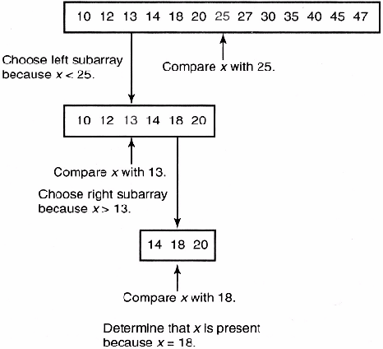
x=18

Slide 54
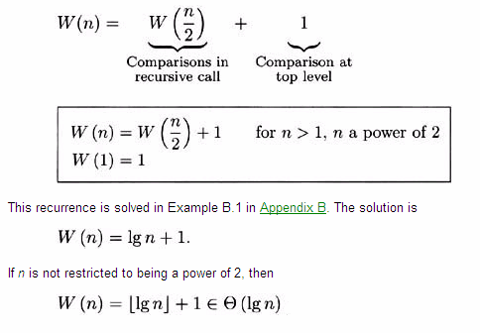
Analysis of Algorithm Worst-Case Time Complexity (Binary Search, Recursive)

Slide 55
Successful search
Best : O(1)
Average : O(log n)
Worst: O(log n)
Unsuccessful search : O(log n)

Slide 56
Example: Find the MAX and MIN
Obvious strategy (Needs 2n - 3 compares)
Find MAX (n - 1 compares)
Find MIN of the remaining elements (n - 2)
Nontrivial strategy
Split the array in half
Find the MAX and MIN of both halves
Compare the 2 MAXes and compare the 2 MINs to get overall MAX and MIN.
In this example, we only consider the number of comparisons and ignore all other operations.

Slide 57
Procedure mm(i, j: integer; var lo, hi: integer);
begin
if i = j
then begin lo := a[i]; hi := a[i] end
else if i = j-1
then begin if a[i] < a[j]
then begin lo := a [i]; hi := a[j] end
else begin lo := a [j]; hi := a[i] end
end
else begin
m := (i+j) div 2;
mm(i, m, min1, max1);
mm(m+1, j, min2, max2);
lo := MIN(min1, min2);
hi := MAX(max1, max2)
end
end.

Slide 58
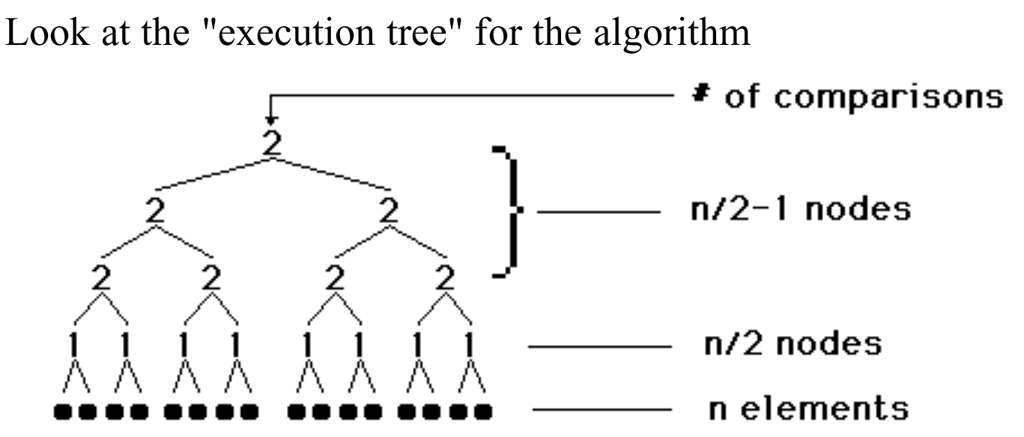
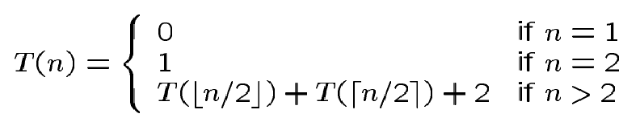
Analysis

Slide 59
Note
More accurately, it should be
Solving the above, we have T(n) = 3n/2 –2 if n is a power of 2.
This can be shown to be a lower bound.

Slide 60
Merge sort
The merge sort algorithm closely follows the divide-and-conquer paradigm. Intuitively, it operates as follows. Divide: Divide the n-element sequence to be sorted into two subsequences of n/2 elements each. Conquer: Sort the two subsequences recursively using merge sort. Combine: Merge the two sorted subsequences to produce the sorted answer.

Slide 61
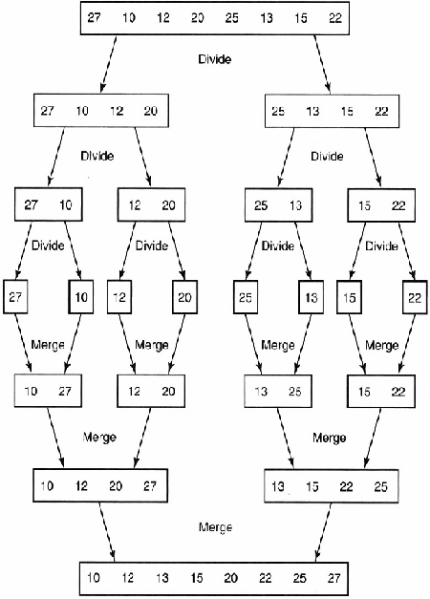

Slide 62
Merge sort using recursion
Input: An array A and indices low and high Output: An sorted array A MERGE-SORT(A, low, high) 1. if low< high 2. then mid = (low + high) / 2 3. MERGE-SORT(A, low, mid)
4. MERGE-SORT(A, mid+1, high) 5. MERGE(A, low, mid, high)

Slide 63
Algorithm: Merging 2 sorted subarrays using auxiliary storage.
Algorithm merge(low,mid,high)
//a[low:high] is a global array containing
//two sorted subsets in a[low:mid]
//and in a[mid+1:high].The goal is to merge these 2 sets into
//a single set residing in a[low:high].b[] is an auxiliary global array.

Slide 64
{
h=low; I=low; j=mid+1;
while ((h<=mid) and (j<=high)) do
{
if (a[h]<=a[j]) then
{
b[I]=a[h];
h = h+1;
}

Slide 65
else
{
b[I]= a[j];
j=j+1;
}
I=I+1;
}

Slide 66
if (h=mid) then
for k=j to high do
{
b[I]=a[k]; I=I+1;
}
else
for k=h to mid do
{ b[I]=a[k]; I=I+1; }
for k=low to high do a[k] = b[k];
}

Slide 67
Time Complexity –Merge Sort
T(n) =a n=1 a is constant
= 2T(n/2) + cn. n>1 c is constant In the same way: T(n/2) = 2T(n/4) + cn/2, so T(n) = 4T(n/4) + 2cn. Going in this way ...
T(n) = 2^{k}T(n/2^{k}) + kcn
= nT(1) + cnlog₂n = O(n log n).
Remember, as n=2^{k} k = log₂n!
The general case requires a bit more work, but it takes O(n log n) time anyway.

Slide 68
Introduction
Quicksort
Fastest known sorting algorithm in practice
Average case: O(N log N)
Worst case: O(N²)
But, the worst case seldom happens.

Slide 69
Quicksort
S
Divide step:
Pick any element (pivot) v in S
Partition S – {v} into two disjoint groups
S1 = {x ∈ S – {v} | x <= v}
S2 = {x ∈ S – {v} | x ≥ v}
Note: S1 and S2 may overlap. Why?
Conquer step: recursively sort S1 and S2
Combine step: the sorted S1 (by the time returned from recursion), followed by v, followed by the sorted S2 (i.e., nothing extra needs to be done)
v
v
S1
S2

Slide 70
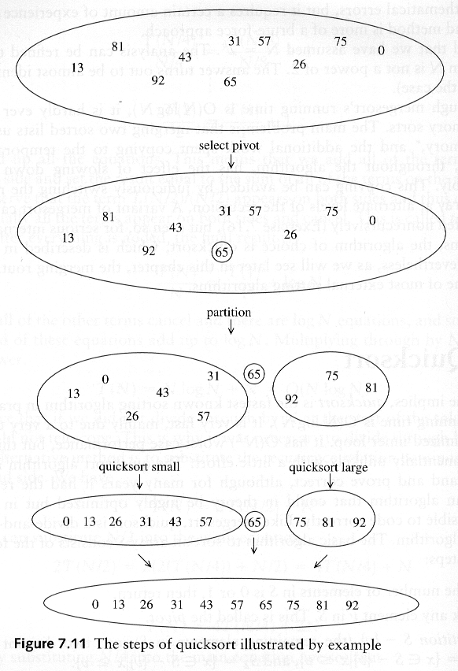
Example: Quicksort

Slide 71
Example: Quicksort...

Slide 72
Pseudocode
Input: an array A[p, r]
Quicksort (A, p, r) {
if (p < r) {
q = Partition (A, p, r) //q is the position of the pivot element
Quicksort (A, p, q-1)
Quicksort (A, q+1, r)
}
}

Slide 73
Partitioning
Partitioning
This is a key step of the quicksort algorithm
Goal: given the picked pivot, partition the remaining elements into two smaller sets
Many ways to implement how to partition:
Even the slightest deviations may cause surprisingly bad results.
We will learn an easy and efficient partitioning strategy here.
How to pick a pivot will be discussed later

Slide 74
Partitioning Strategy
Want to partition an array A[left .. right]
First, get the pivot element out of the way by swapping it with the last element. (Swap pivot and A[right])
Let i start at the first element and j start at the next-to-last element (i = left, j = right – 1)
swap
5
6
4
6
3
12
19
5
6
4
19
3
12
6
pivot
i
j

Slide 75
Partitioning Strategy
Want to have
A[p] <= pivot, for p < i
A[p] >= pivot, for p > j
When i < j
Move i right, skipping over elements smaller than the pivot
Move j left, skipping over elements greater than the pivot
When both i and j have stopped
A[i] >= pivot
A[j] <= pivot { A[i] and A[j] should now be swapped}
<= pivot
>= pivot
i
j
5
6
4
19
3
12
6
5
6
4
19
3
12
6
i
j
i
j

Slide 76
Partitioning Strategy
When i and j have stopped and i is to the left of j (thus legal)
Swap A[i] and A[j]
The large element is pushed to the right and the small element is pushed to the left
After swapping
A[i] <= pivot
A[j] >= pivot
Repeat the process until i and j cross
swap
5
6
4
19
3
12
6
5
3
4
19
6
12
6
i
j
i
j

Slide 77
Partitioning Strategy
5
3
4
19
6
12
6
When i and j have crossed
Swap A[i] and pivot
Result:
A[p] <= pivot, for p < i
A[p] >= pivot, for p > i
i
j
5
3
4
19
6
12
6
Swap!
i
j
5
3
4
6
6
12
19
break!
j
i

Slide 78
Conventional Matrix Multiplication
Brute-force algorithm
c₀₀ c₀₁ a₀₀ a₀₁ b₀₀ b₀₁
= *
c₁₀ c₁₁ a₁₀ a₁₁ b₁₀ b₁₁
a₀₀ * b₀₀ + a₀₁ * b₁₀ a₀₀ * b₀₁ + a₀₁ * b₁₁
=
a₁₀ * b₀₀ + a₁₁ * b₁₀ a₁₀ * b₀₁ + a₁₁ * b₁₁
8 multiplications
Efficiency class in general: Θ (n³)
4 additions

Slide 79
Strassen’s Matrix Multiplication
Strassen’s algorithm for two 2x2 matrices (1969):
c₀₀ c₀₁ a₀₀ a₀₁ b₀₀ b₀₁
= *
c₁₀ c₁₁ a₁₀ a₁₁ b₁₀ b₁₁
m₁ + m₄ - m₅ + m₇ m₃ + m₅
=
m₂ + m₄ m₁ + m₃ - m₂ + m₆
m₁ = (a₀₀ + a₁₁) * (b₀₀ + b₁₁)
m₂ = (a₁₀ + a₁₁) * b₀₀
m₃ = a₀₀ * (b₀₁ - b₁₁)
m₄ = a₁₁ * (b₁₀ - b₀₀)
m₅ = (a₀₀ + a₀₁) * b₁₁
m₆ = (a₁₀ - a₀₀) * (b₀₀ + b₀₁)
m₇ = (a₀₁ - a₁₁) * (b₁₀ + b₁₁)
7 multiplications
18 additions

Slide 80
Strassen’s Matrix Multiplication
Strassen observed [1969] that the product of two matrices can be computed in general as follows:
C₀₀ C₀₁ A₀₀ A₀₁ B₀₀ B₀₁
= *
C₁₀ C₁₁ A₁₀ A₁₁ B₁₀ B₁₁
M₁ + M₄ - M₅ + M₇ M₃ + M₅
=
M₂ + M₄ M₁ + M₃ - M₂ + M₆

Slide 81
Formulas for Strassen’s Algorithm
M₁ = (A₀₀ + A₁₁) ∗ (B₀₀ + B₁₁)
M₂ = (A₁₀ + A₁₁) ∗ B₀₀
M₃ = A₀₀ ∗ (B₀₁ - B₁₁)
M₄ = A₁₁ ∗ (B₁₀ - B₀₀)
M₅ = (A₀₀ + A₀₁) ∗ B₁₁
M₆ = (A₁₀ - A₀₀) ∗ (B₀₀ + B₀₁)
M₇ = (A₀₁ - A₁₁) ∗ (B₁₀ + B₁₁)

Slide 82
Analysis of Strassen’s Algorithm
If n is not a power of 2, matrices can be padded with zeros.
Number of multiplications:
M(n) = 7M(n/2), M(1) = 1
Solution: M(n) = 7^{log 2n} = n^{log 27} ≈ n^{2.807} vs. n³ of brute-force alg.
Algorithms with better asymptotic efficiency are known but they are even more complex and not used in practice.
What if we count both multiplications and additions?

